Slide 1


CarbonCredz
An Automated Carbon Credit System and CO2 Tracker
Mentor: Dr. Rajkumar Tekchandani (Assistant Professor)
Team Members:
Anubhav Gupta 102003551
Atharv Ambokar 102003564
Gurkirat Singh 102003172
Parth Nasa 102003147

Slide 2

Table of Contents
Problem Statement
Project Scope
Objectives
Literature Survey
Tools and Techniques Used
Work Breakdown Structure
Project Architecture
Class Diagram & User Interface Diagram
Workflow & Deployment Diagram
System Screenshots
Project Outcomes
Individual Roles
Work Plan
3
4
5
6
7
8
9
10
11
12
14
15
16

Slide 3

Problem Statement
The current carbon credit system lacks transparency and reliability, making it difficult to accurately track and report their CO2 emissions.
Many businesses struggle with the complexities of monitoring their emissions and verifying reductions, which are essential for earning carbon credits.
Existing platforms for trading carbon credits often lack efficiency and accessibility, limiting participation and slowing the overall progress toward environmental sustainability.
This fragmentation and inefficiency in both emission tracking and carbon credit trading present significant barriers to achieving meaningful reductions in industrial CO2 emissions and combating climate change.
There is a pressing need for an integrated, transparent, and reliable system that can streamline these processes and foster greater environmental accountability and action.

Slide 4
Project Scope
Developing a blockchain-based automated carbon credit system using the XDC Blockchain EVM.
Carbon credits trading through the XRC-20 Token (GCT).
CO2 emissions will be tracked using graphical reports.
Security is reinforced with a KYC verification using IPFS.
A user-friendly decentralized marketplace created for carbon credit trading.

Slide 5

Objectives
Establishment of a Carbon Decentralized Marketplace to facilitate a transparent carbon trading
Implementation of an Automated Carbon Credit System to streamline the process of issuing and managing carbon credits
Provision for individuals to contribute to carbon reduction efforts.

Slide 6
Literature Survey
Year | Paper Title | Tools/Technology | Findings | Citation
2020 | Estimation of Carbon Emission from Thermal Power Plants in India | Solar PV systems, RETScreen, HOMER, EnergyPlus, ArcGIS, QGIS, TensorFlow, PyTorch. | Rise of CO2 emissions in India, mainly from thermal power plants; exploring carbon trading as a solution. | G. Sharma, Isha Narolia, A. Sharma, P. Singh[6]
2020 | Carbon credits on blockchain | Clean Development Mechanism (CDM), Zotero, Digital Signatures, Emission Trading Scheme | Proposes a blockchain-based token system for carbon trading to address issues like centralization and fraud in current carbon credit markets. | D. Patel, B. Britto, S. Sharma, K. Gaikwad, Y. Dusing, M. Gupta[7]
2022 | Blockchain-enhanced trading systems for construction industry to control carbon emissions | Delegated Proof of Stake (DPoS), Carbon Emission Calculation Software (CCS), Decentralized Application (DApp) | Proposes a blockchain-based trading system to control carbon emissions in the construction industry's materialization phase. | Z. Shu, W. Liu, B. Fu, Z. Li, M. He[8]
2023 | Trading carbon tokens on the blockchain | AirCarbon Exchange (ACX), Wallet Addresses, Carbon Trade Exchange (CTX) | Blockchain-based exchange for trading voluntary carbon credits, its development, operation, and impact on reducing carbon emissions through financial innovation. | L. Swinkels[10]
2023 | Design of Service System for Carbon Trading (Case Study : Bandung City) | Data Collection, Carbon Calculation System, Geographic Information System (GIS), Visualization software for generating dashboards | A carbon trading-based system to address carbon emissions in Bandung City; it collects data on vegetation absorption ability and vehicle emissions to calculate carbon tax costs and incentivize emission reduction efforts. | M. R. Dwi Putra, Albarda[11]

Slide 7
Tools and Technologies Used
Python (v3.10)
NodeJS (v20.11)
Truffle (v5.7.7)
For API development and interfacing REST API with blockchain, due to its simplicity, extensive libraries, and strong community support
For backend development to handle API requests, manage user authentication, and interact with the blockchain
For smart contract development, testing, and deployment on the blockchain
XDC Blockchain EVM
IPFS System
Frontend Development Frameworks (React)
Blockchain platform for its EVM compatibility, robustness, and suitability for enterprise applications
For decentralized storage of verification documents, such as KYC data
For building a user-friendly web interface

Slide 8
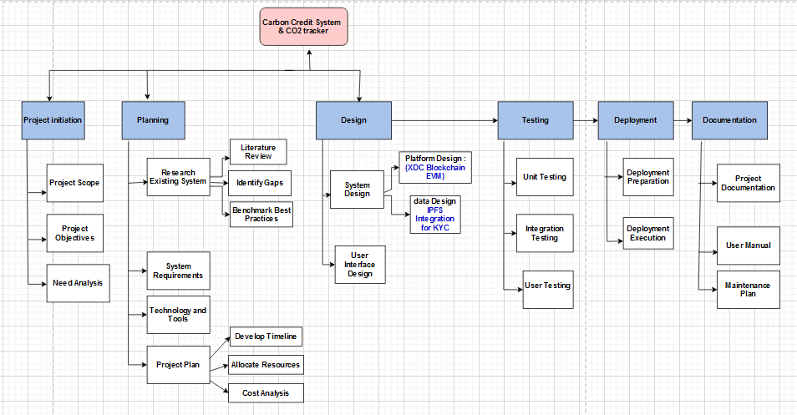

Work Breakdown Structure

Slide 9
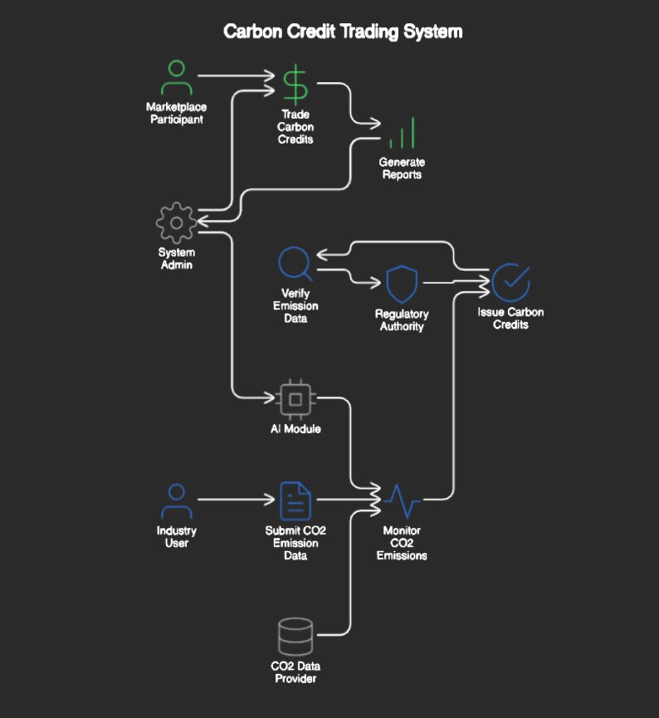
System Architecture Diagram

Slide 10
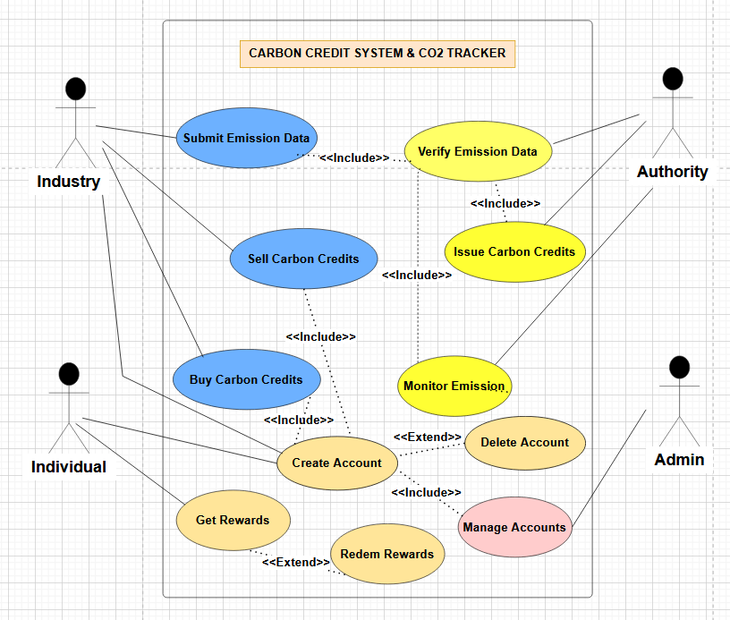
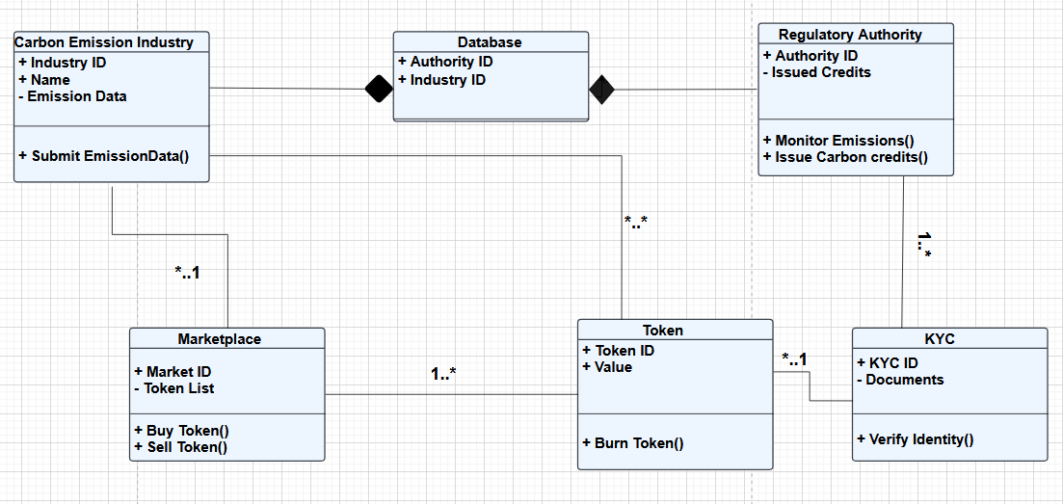
Class Diagram
User Interface Diagram

Slide 11

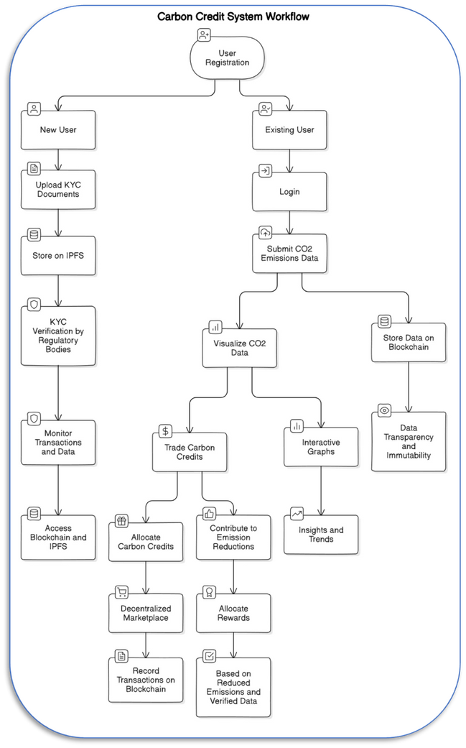
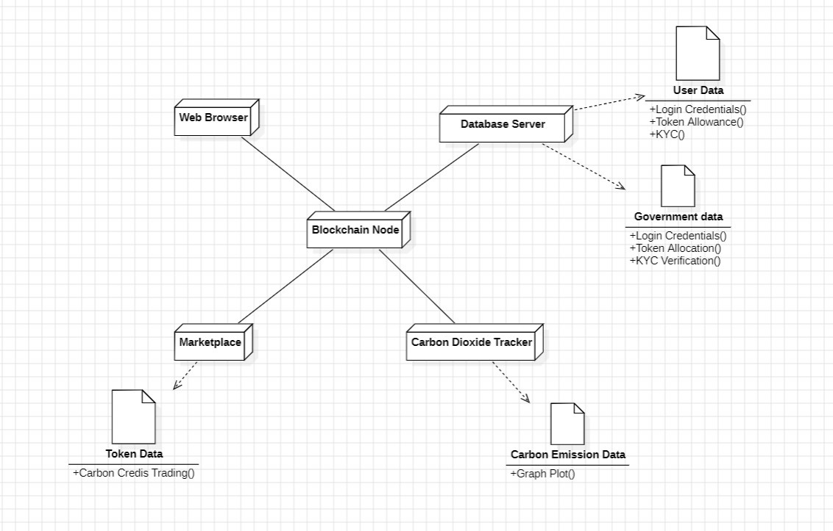
Deployment Diagram
Workflow

Slide 12
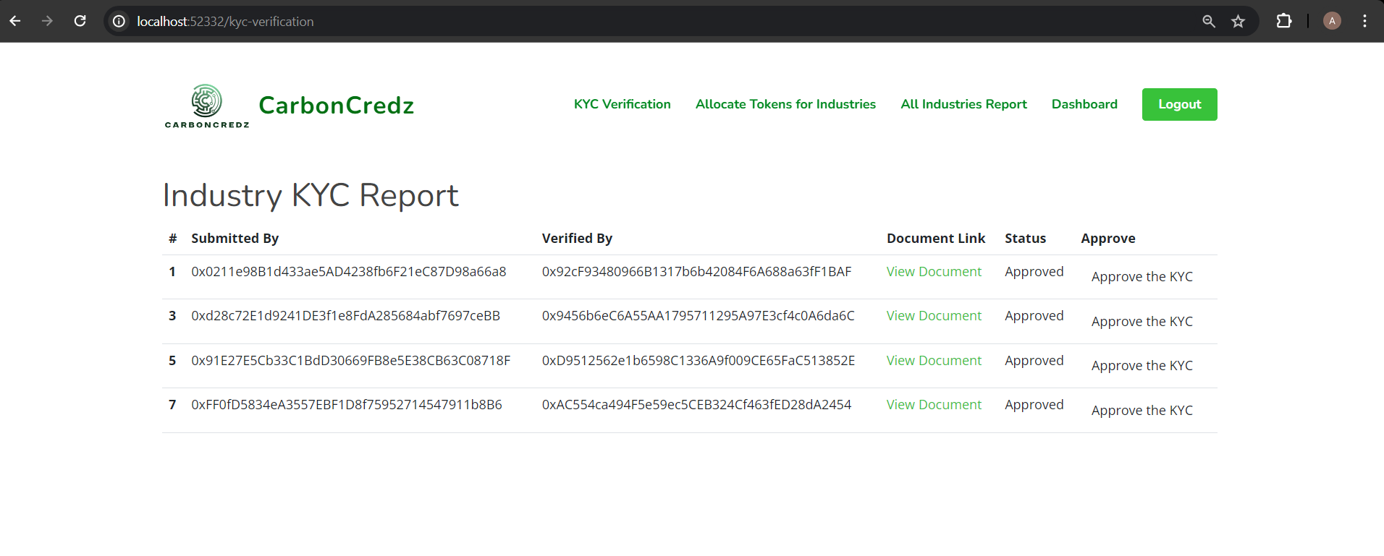
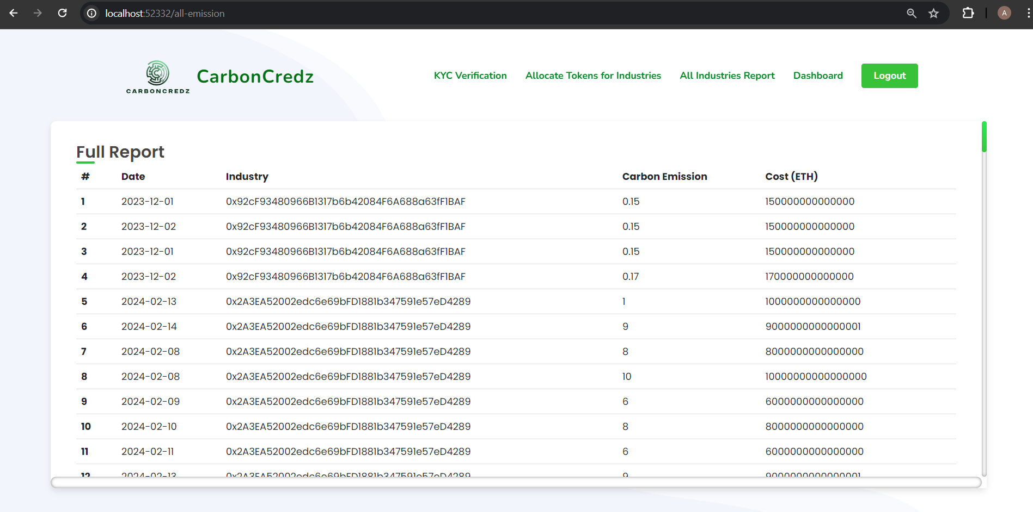
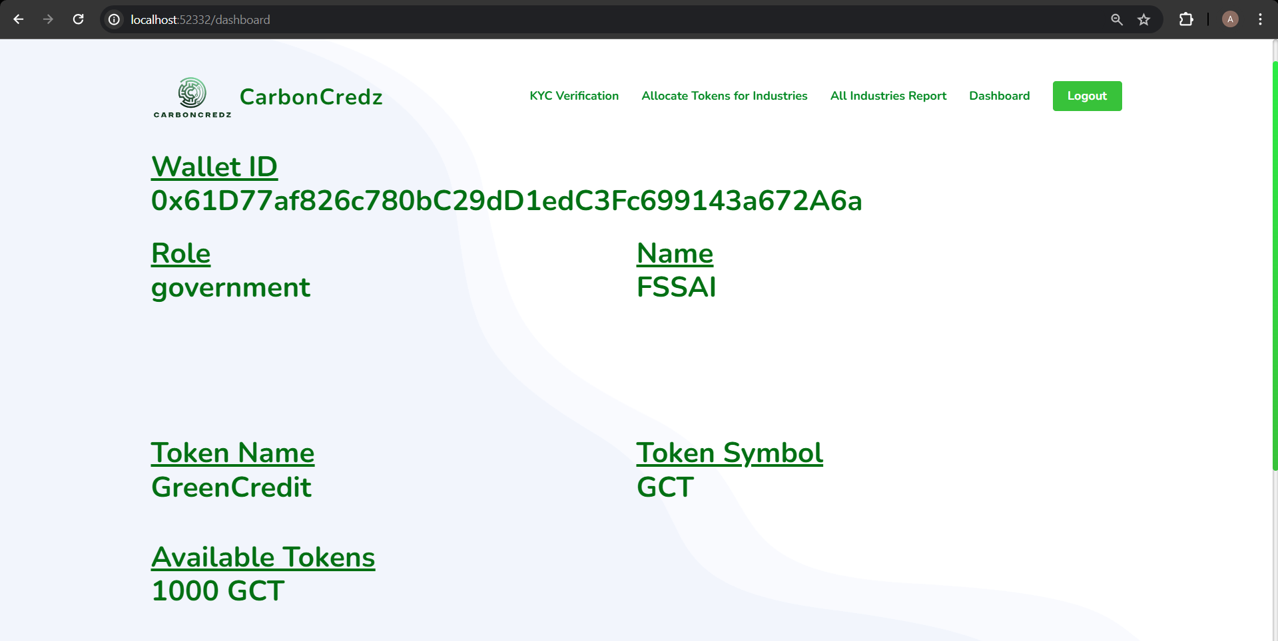
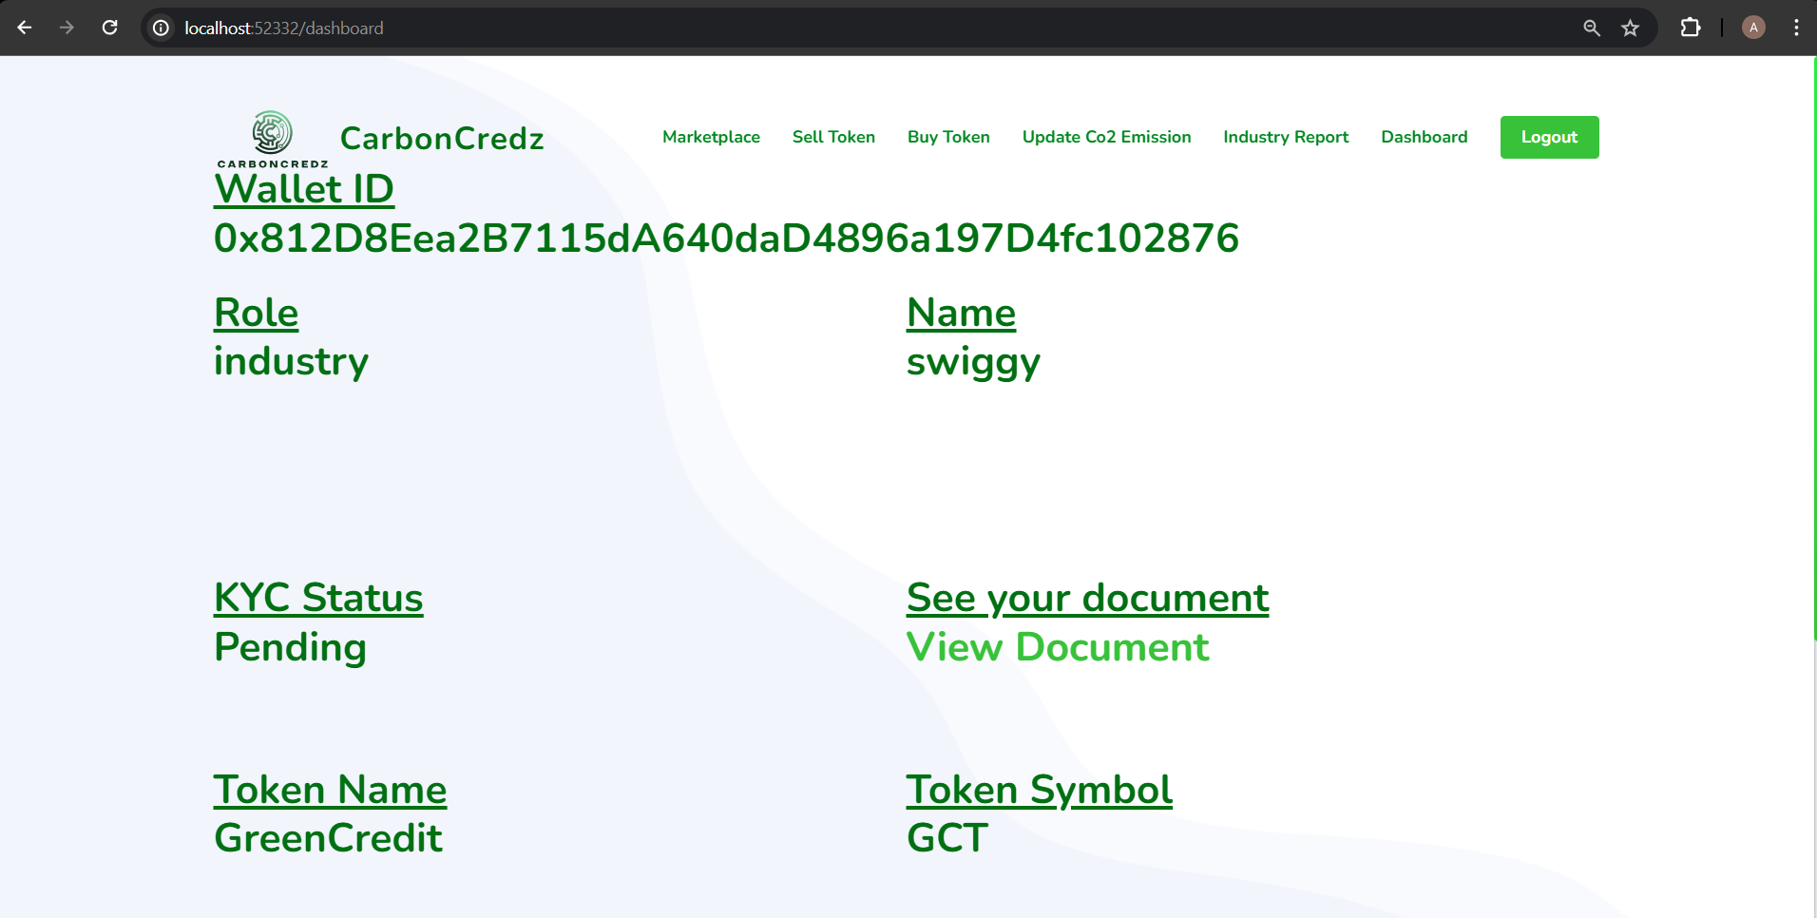
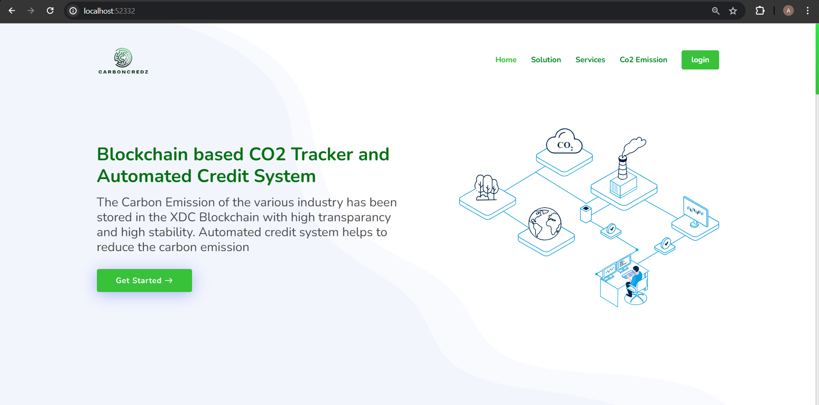
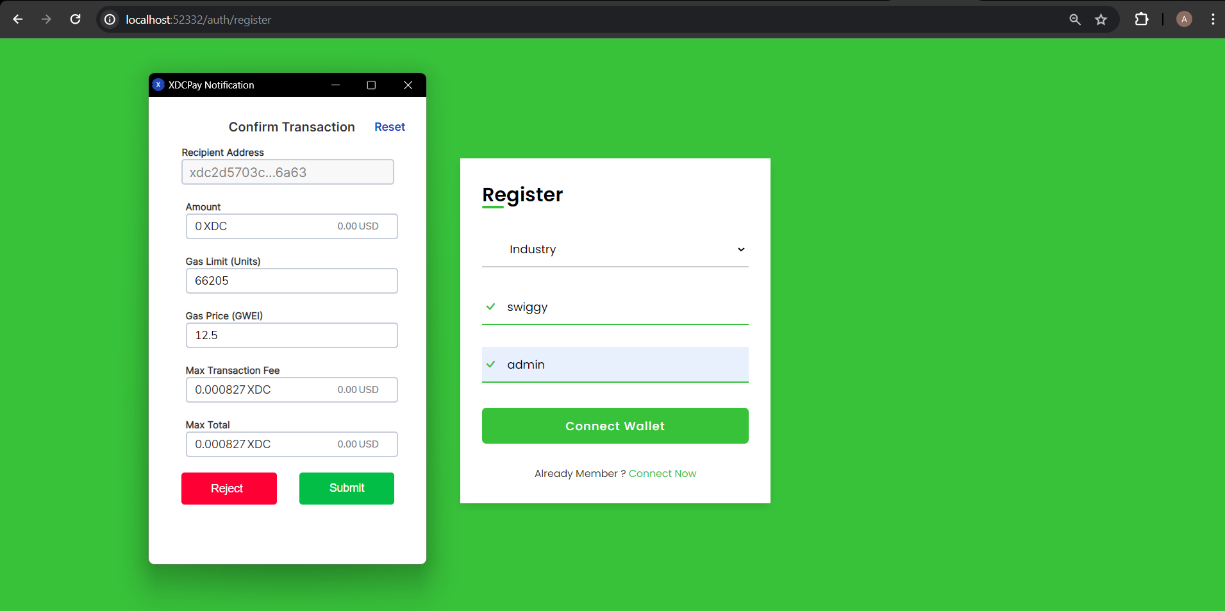
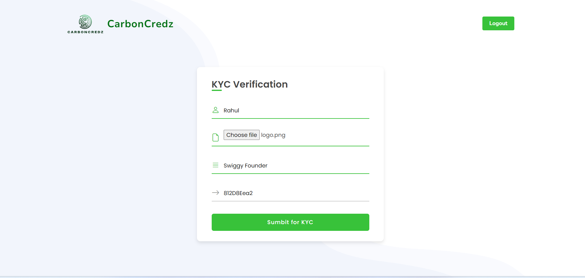
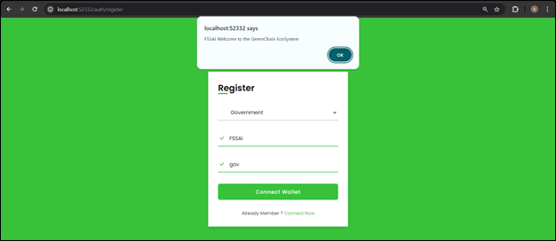
System Screenshots
Notes:
Pic #1 – Industry User Registration
#2 – KYC Verification
#3 and #4 – User Interface for Industry User
#5 and #6 – Govt. Registration and Dashboard
#7and #8 – KYC Verification and CO2 Emission Report by Industries

Slide 13
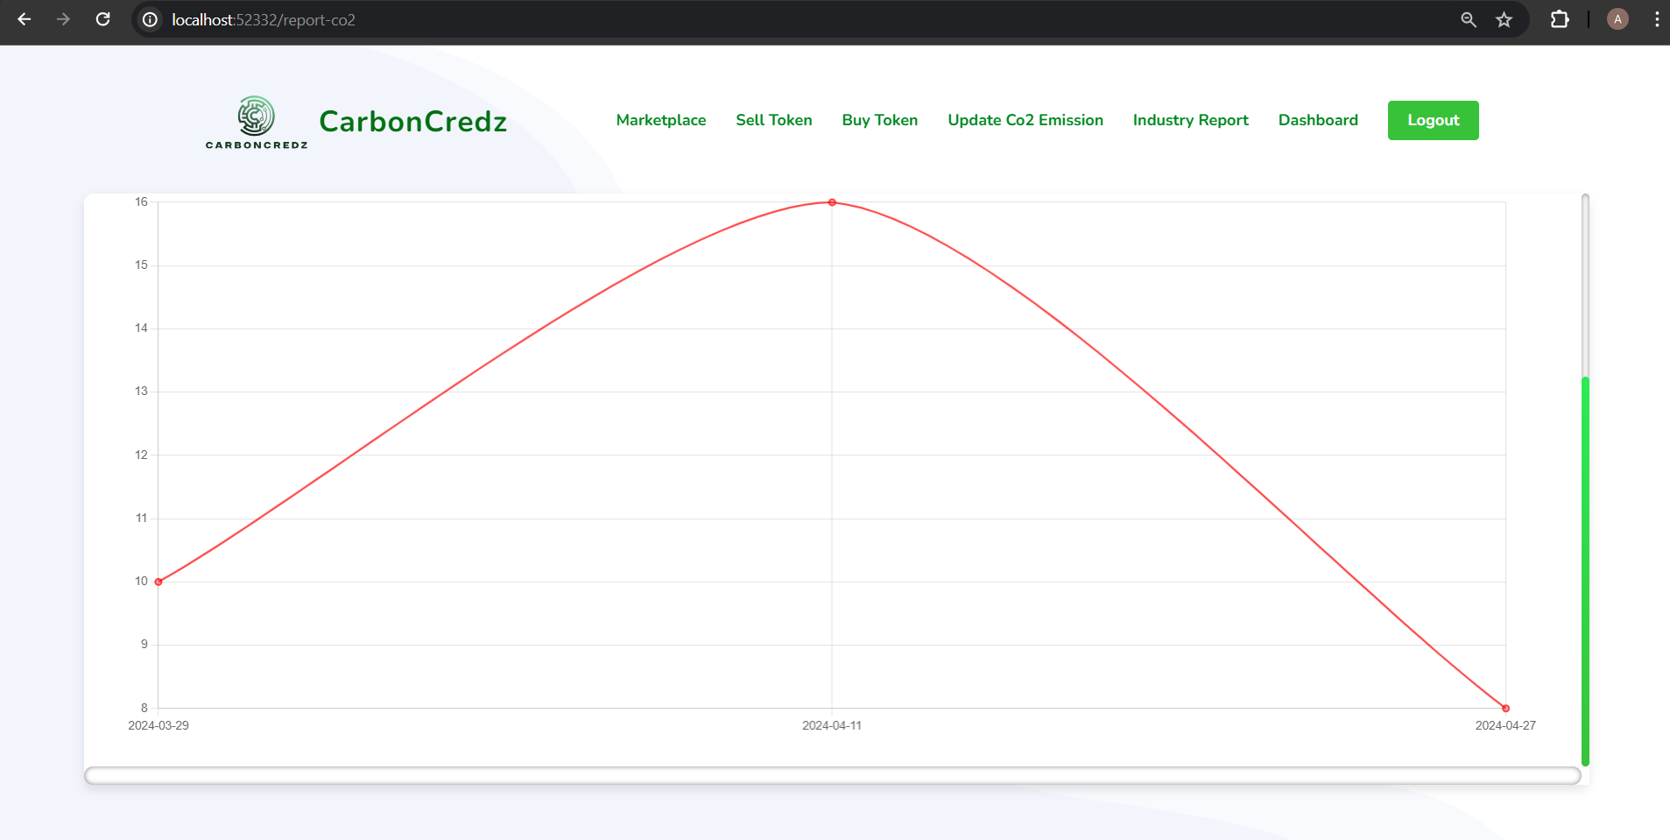
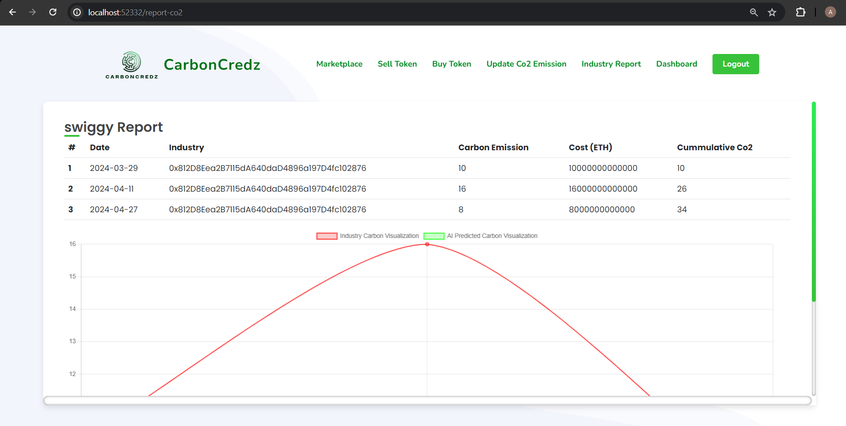
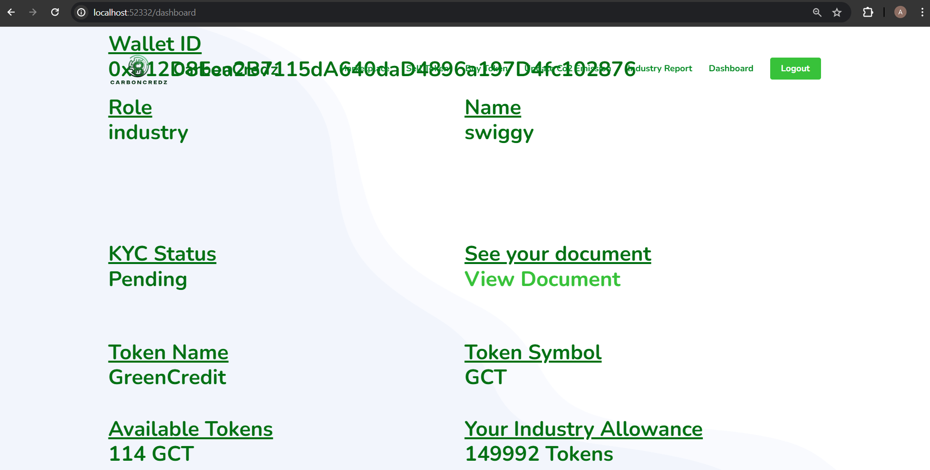
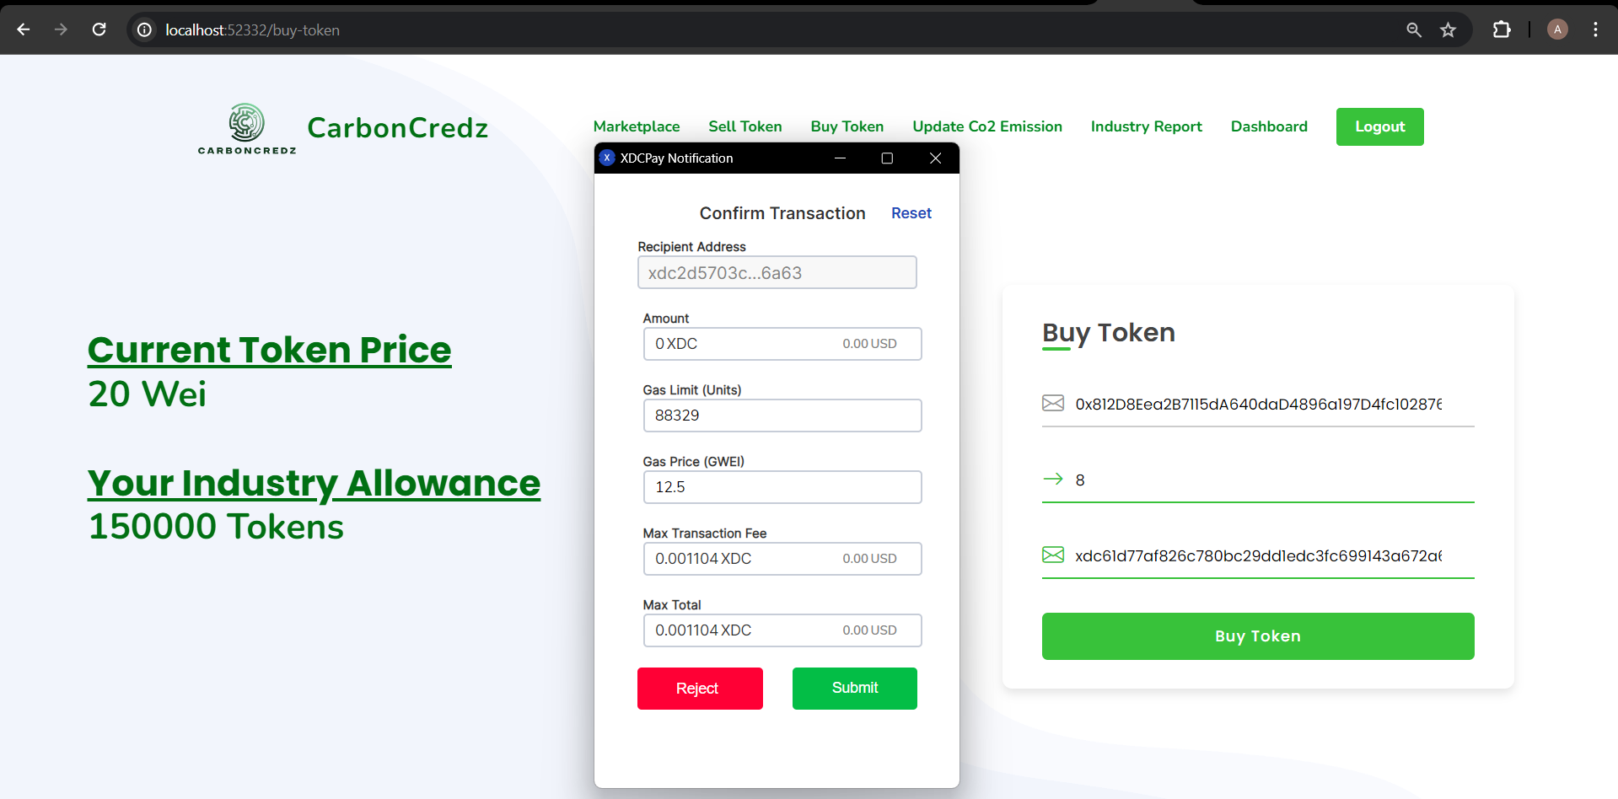
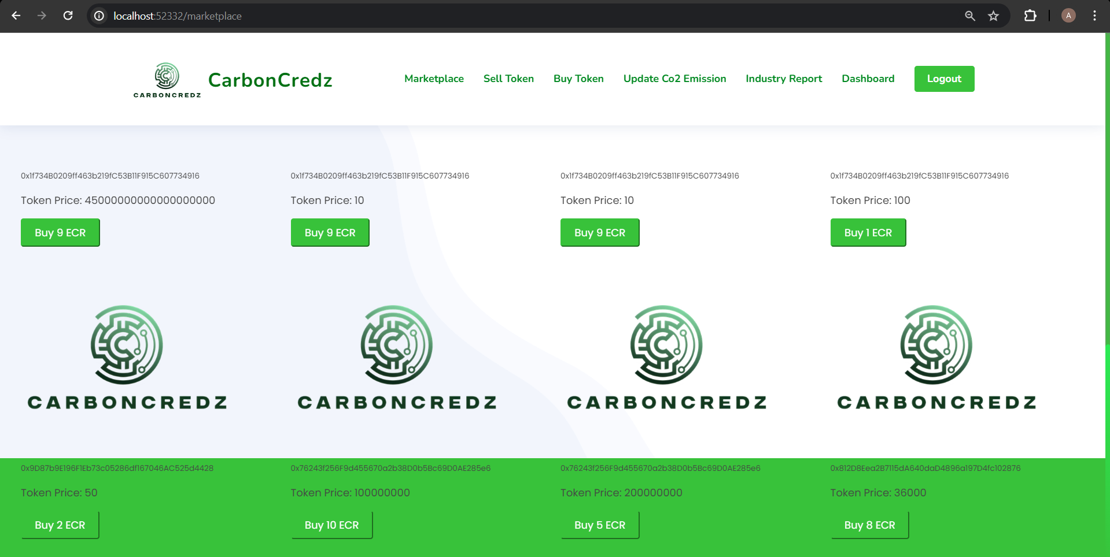
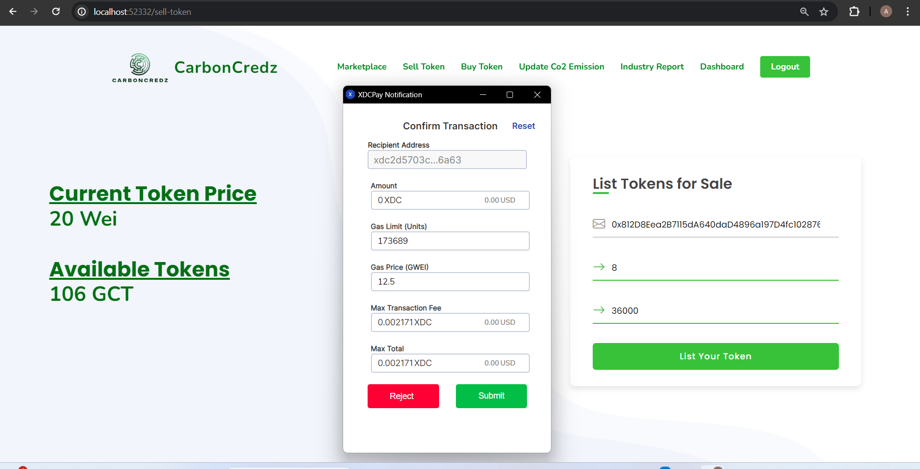
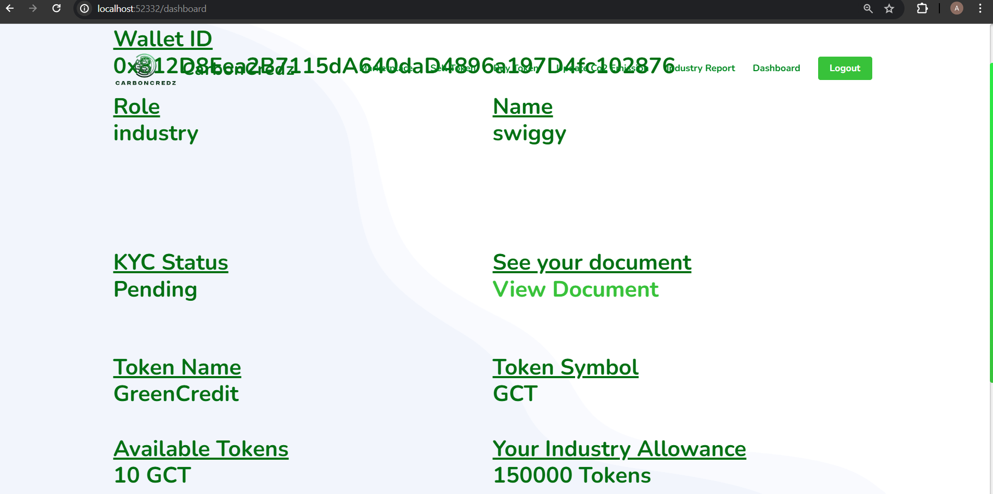
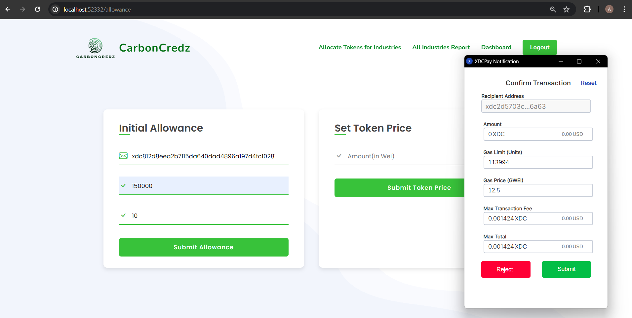
System Screenshots: Results
Notes:
#1 and #2 – Allocation of tokens to Industry via Govt.
#3 and #4 – Carbon Credits Trading in a Decentralized Marketplace
#5 and #6 – Carbon Credits Trading with Government
#7 and #8 - Graphs

Slide 14
Fully Functional Blockchain System
Efficient CO2 Tracker System
User-Friendly Decentralized Marketplace
KYC and Security Measures
Project Outcomes

Slide 15
Project Manager: Atharv Ambokar
Front End Developer: Anubhav Gupta
Back End Developers: Parth Nasa, Gurkirat Singh
Individual Roles

Slide 16
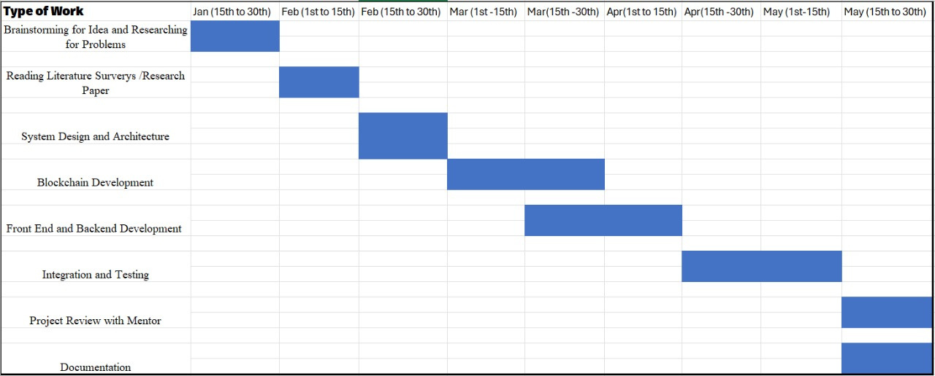
Work Plan

Slide 17
Thank
you!

